Slide 1
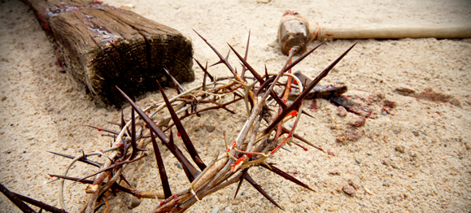
آلام المسيح
كريستولوجيا: شخص وعمل يسوع
د. ريك جريفيث• الهيئة الانجيلية الثقافية- الأردن• BibleStudyDownloads.org

Slide 2

ما هو الأمر الجيد بخصوص الجمعة العظيمة ؟
Notes:
لكن هذا الاسم محير بنفس القدر. لماذا تسمى الجمعة العظيمة "بالعظيمة"؟
مات قائدنا في ذلك اليوم ، لذلك يبدو من الغريب أن نطلق على اليوم "العظيمة". لا يوجد دين آخر يشير إلى وفاة زعيمهم على أنها "عظيمة".
نعتقد أن وفاته كانت عظيمة. كيف كان ذلك؟

Slide 3

أسبوع
الآلام
64
الإثنين
الأربعاء
الثلاثاء
الجمعة
الخميس
الجمعة
الأحد
السبت
السبت
الأحد
Notes:
LC-00-NT Chronology-43
NS-01-Matt15-28-slide 139
NS-02-Mark9-16-slide 105
NS-03-Luke13-24-slide 211
NS-04-John12-21-slide 294

Slide 4
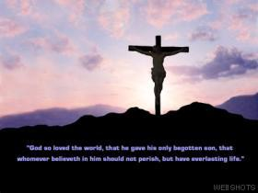
مات من أجلك!
يوحنا 19: 16ب-42

Slide 5


حب
Notes:
What does love look like?

Slide 6

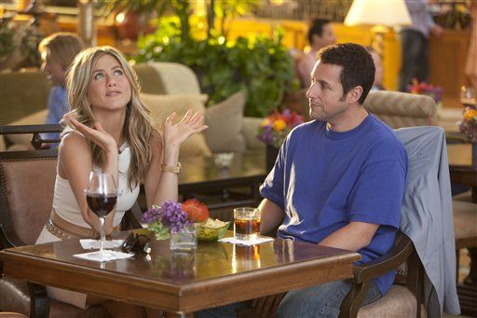
Just Go With It
Notes:
Is it sentimental?

Slide 7

Just Go With It
Notes:
Emotional?

Slide 8
JOHN 15:13
"GREATER LOVE HAS NO ONE THAN THIS, THAN TO LAY DOWN ONE'S LIFE FOR HIS FRIENDS."
Notes:
As Christians, we know that love doesn’t masquerade in immorality and lies for personal pleasure.
Love gives the very best—which is life itself. Jesus said it well in John 15:13, “Greater love has no one than this, than to lay down one’s life for his friends.”

Slide 9
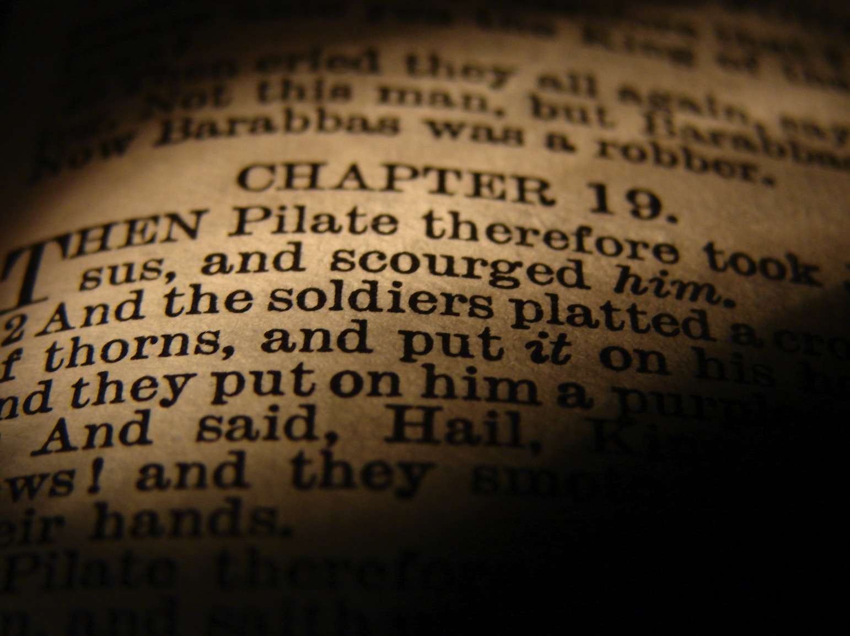
مات عنك
لكن كيف نعرف أن موت المسيح دفع ثمن خطايانا بالفعل ؟
Notes:
We began with the question, “How do we know that Christ’s death actually paid for our sin?” So how can we be sure his death was unlike any other? I sum up the whole passage in this way…

Slide 10
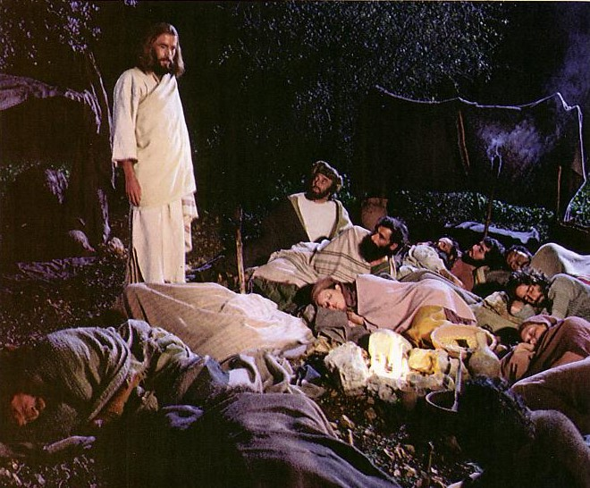
سيطر يسوع على اعتقاله
(يوحنا 18: 1-11)

Slide 11
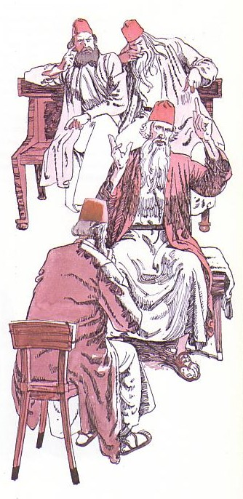
أثبتت محاكمات يسوع
غير القانونية برائته
(18: 12-19: 16أ)
Notes:
Then his six illegal trials proved him innocent!

Slide 12
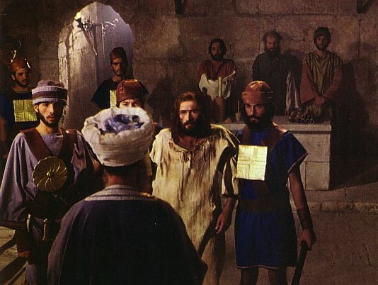
المحاكمات اليهودية : حنان
غير قانوني
لم يعد رئيس كهنة
في الليل
في بيت
لا يوجد شهود
لا تهمة حقيقية
ظلم
غير قانوني
غير قانوني
غير قانوني
غير قانوني
غير قانوني
Notes:
The trial by Annas was illegal.

Slide 13

قيافا و المحاكمة غير القانونية
غير قانوني
اجتماع مغلق
في بيت قيافا
أقيمت في الليل
لا تهم محددة
تغيير التهم
لا هيئة دفاع
الحكم محدد سلفاً
الرشوة
لا فترة انتظار
Notes:
The trial by Caiaphas was also illegal.

Slide 14

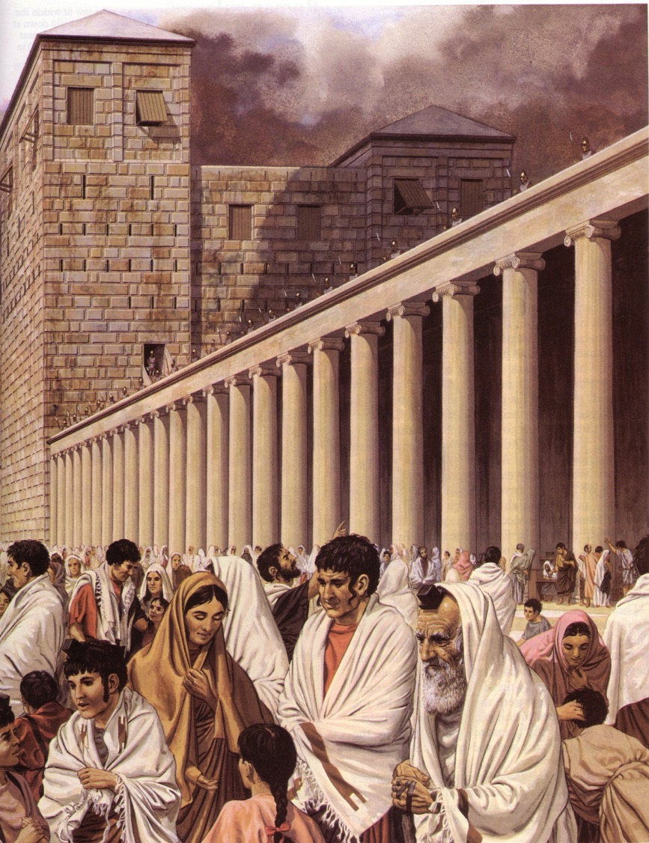
المحاكمات الرومانية
Notes:
Then the trials by Romans were illegal.

Slide 15
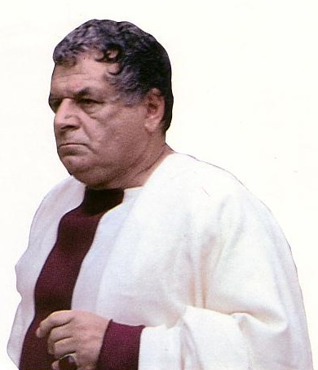
ثلاث محاكمات رومانية ساخرة
غير قانوني
بيلاطس
أنتيباس
بيلاطس (مرة ثانية)
غير قانوني
غير قانوني
التهمة :
الخيانة
Notes:
Then the trials by Romans were illegal. They also charged Jesus treason but never proved their claim.

Slide 16

اليوم : موت يسوع دفع ثمن خطايانا
(19: 16ب-42)
Notes:
Today in John 19:16b-42 we finish the passion account where it shows how Christ voluntarily gave his life for us.

Slide 17
تحركين
الموت
الدفن
Notes:
Today we’ll see true love in two movements—Christ’s death and burial—that they support the concept of his atonement.
The first evidence that Jesus genuinely took our sin upon him was that…

Slide 18

1. تمم المسيح المكتوب من خلال موته غير الأناني (19: 16ب-37)
نكران الذات
التتميم
حمل الصليب
Notes:
Jesus paid for our sin by dying to fulfill prophecy and with utmost care for others.
• Jesus showed selflessness by carrying his own cross (19:16b-17).
The typical criminal had to do this—even those crucified on either side of Christ.

Slide 19
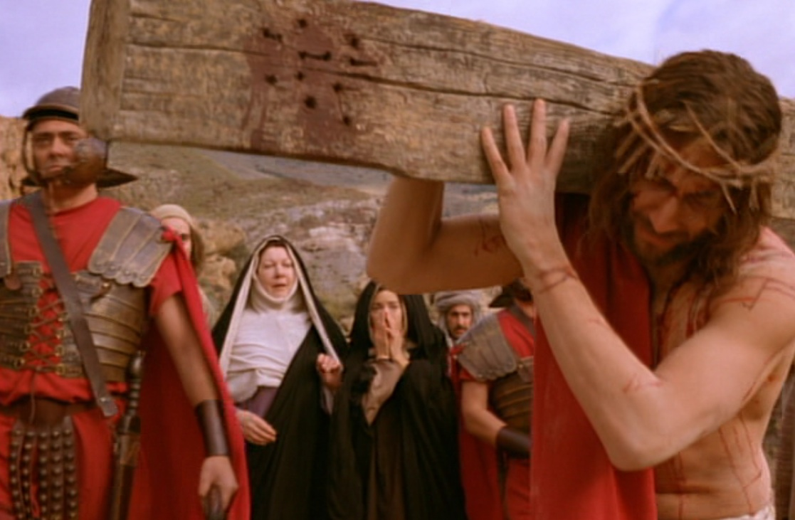
حمل صليبه الخاص
Notes:
But Jesus didn’t have to carry his own cross. Matt. 26:53 says had the power to get out of arrest when he could have called 72,000 angels! That’s 12 legions of angels to defend Him. A Roman legion numbered about 6,000 soldiers.

Slide 20
1. تمم المسيح المكتوب من خلال موته غير الأناني (19: 16ب-37)
نكران الذات
التتميم
حمل الصليب
الصلب
Notes:
Jesus paid for our sin by dying to fulfill prophecy and with utmost care for others.
• Jesus showed selflessness by carrying his own cross (19:16b-17).
The typical criminal had to do this—even those crucified on either side of Christ.

Slide 21
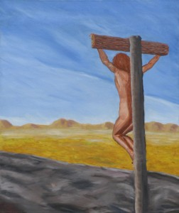
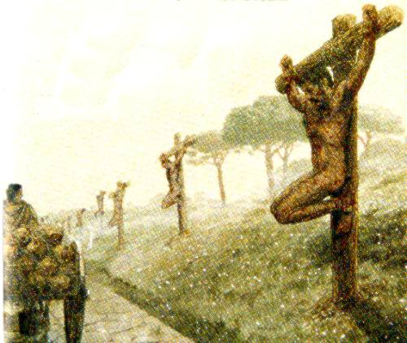
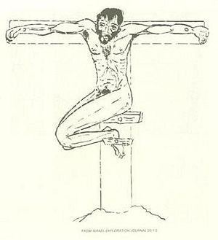
مصلوب عارياً
Notes:
We can’t really imagine the shame of crucifixion today as we execute criminals clothed. But, despite what the movies show, Jesus was totally naked—no loin cloth!

Slide 22
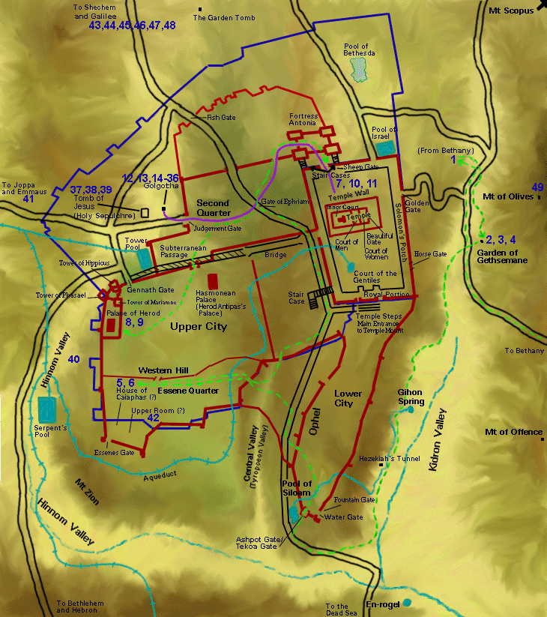
تحركات يسوع الأخيرة
Notes:
Jesus’ crucifixion was definitely public—on a main road either at the Garden Tomb or Church of the Holy Sepulcher.

Slide 23
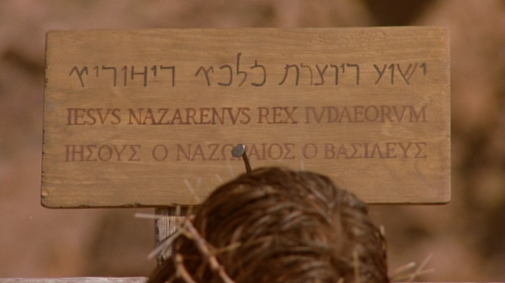
اللافتة
Notes:
To intensify the shame, a sign above Jesus was in three languages so the many who passed by on this key road just outside the city could read it. Passover was the biggest holiday of the year with about 90,000 people in Jerusalem.

Slide 24
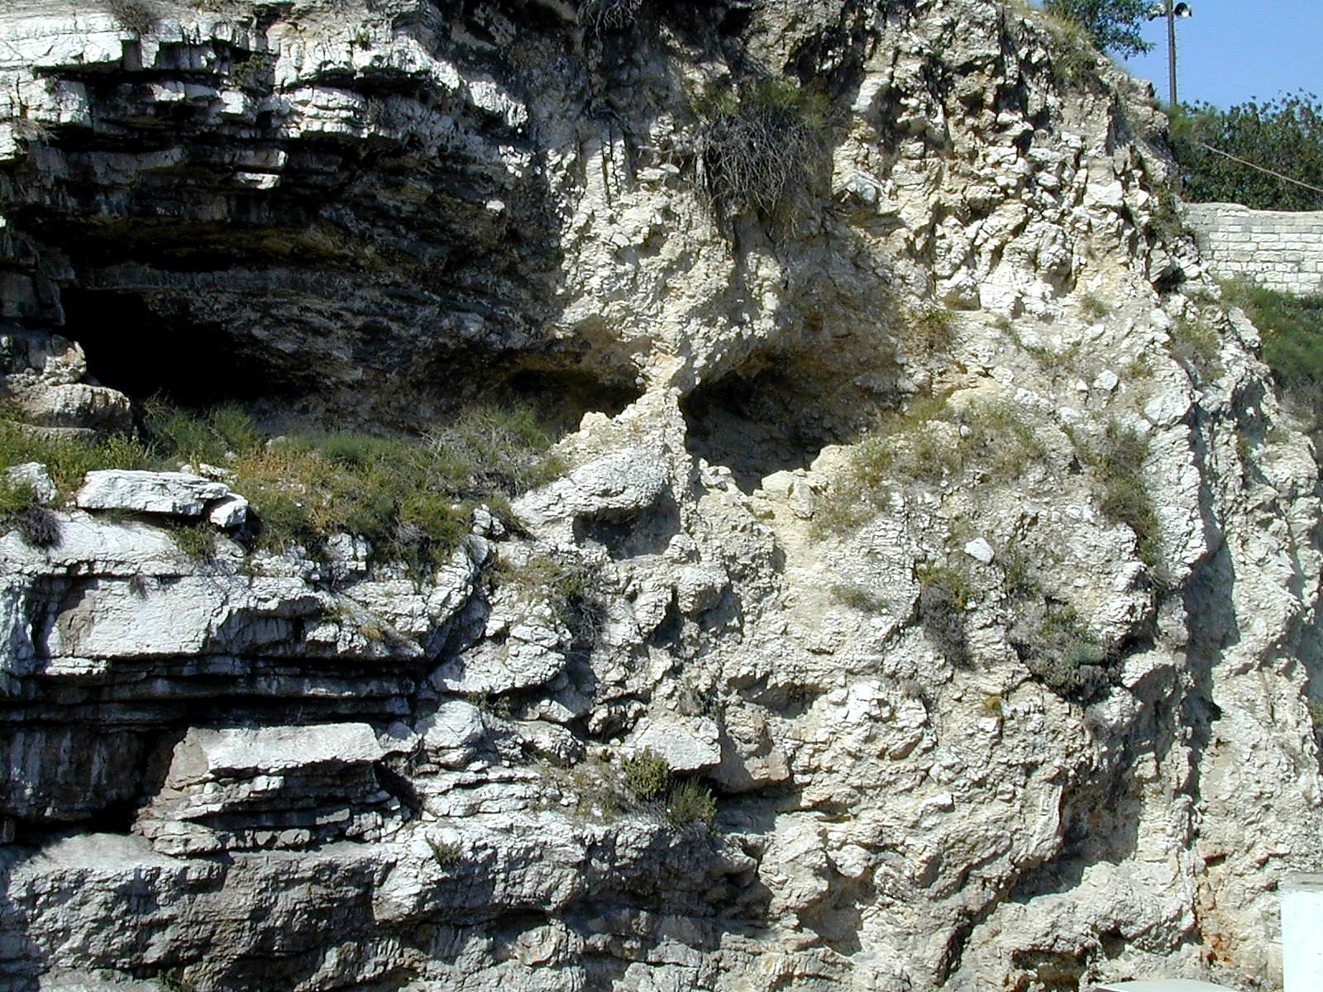
Gordon's Calvary
Notes:
Interestingly, the northern site for the crucifixion of Christ is the outcropping that looks like a skull at Gordon’s Calvary—

Slide 25
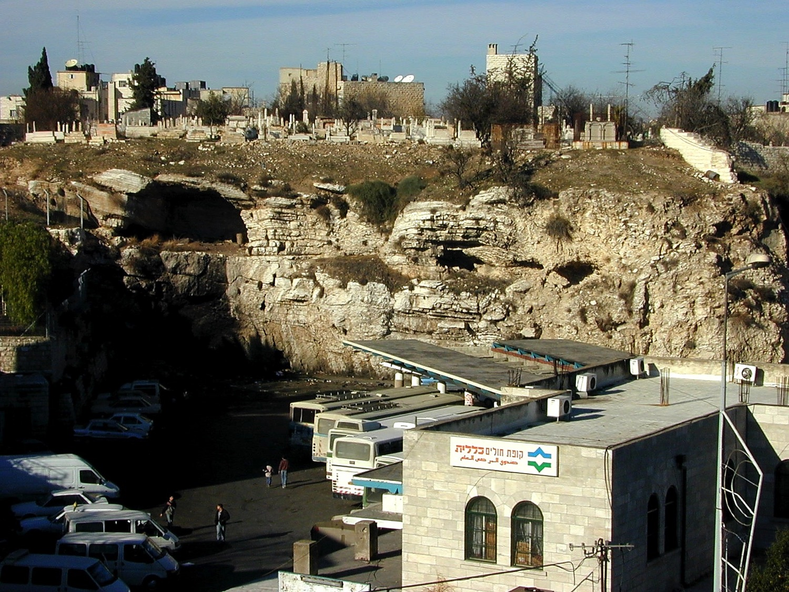
Gordon's Calvary
Notes:
—which is still next to a popular place—a bus station!

Slide 26
1. تمم المسيح المكتوب من خلال موته غير الأناني (19: 16ب-37)
نكران الذات
التتميم
حمل الصليب
اقتسام الملابس
الصلب
Notes:
Jesus paid for our sin by dying to fulfill prophecy and with utmost care for others.
• Jesus showed selflessness by carrying his own cross (19:16b-17).
The typical criminal had to do this—even those crucified on either side of Christ.

Slide 27
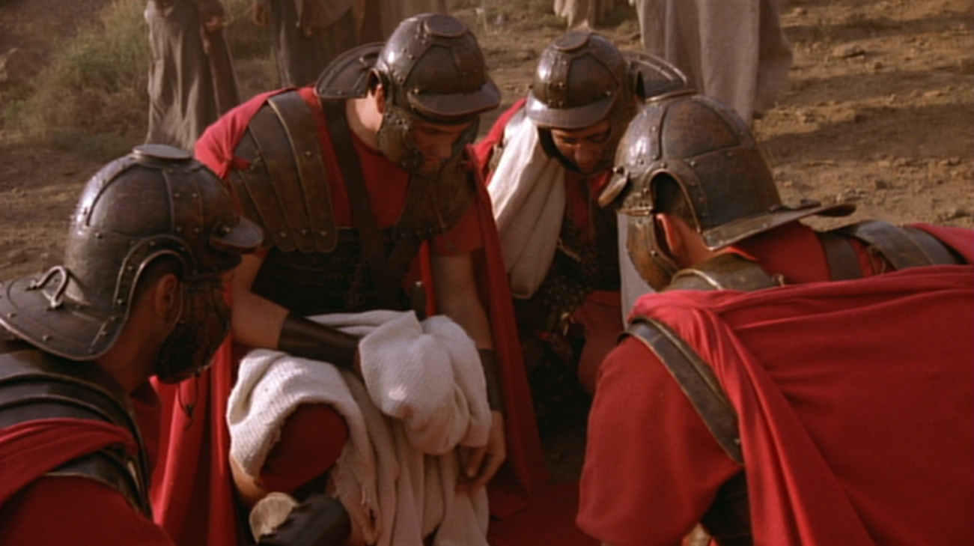
5 أشياء للإقتسام
عمامة - صنادل - روب
لباس خارجي - حزام
Notes:
Wiersbe notes, “At most Roman executions, a centurion would be assigned with four soldiers to assist him… It was the privilege of the soldiers to share whatever personal belongings the victims had; so they divided up all that Jesus owned—His personal clothing. He would have had a turban, a pair of sandals, an undergarment (the seamless robe), an outer garment, and a girdle. The four men each took a piece of clothing, and then they gambled for the seamless robe.”
Warren W. Wiersbe, The Bible Exposition Commentary (Wheaton, Ill.: Victor Books, 1996, c1989), Jn 19:17.

Slide 28
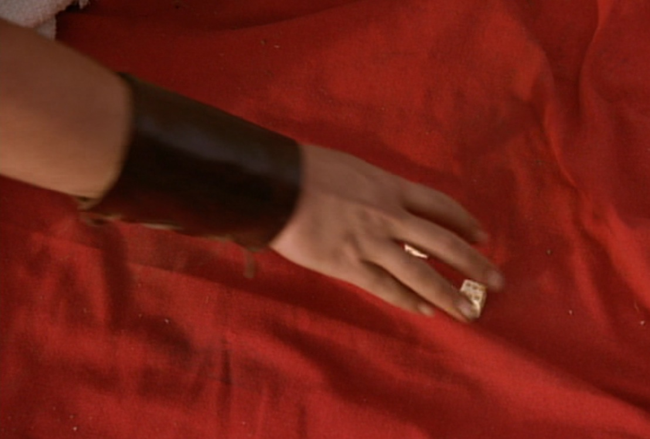
يقتسمون ثيابي بينهم
و على لباسي يقترعون
(مز 22: 18)
Notes:
Psalm 22:18 was fulfilled in, “They divided my garments among themselves and threw dice for my clothing” (19:24 NLT).

Slide 29
1. تمم المسيح المكتوب من خلال موته غير الأناني (19: 16ب-37)
نكران الذات
التتميم
حمل الصليب
اقتسام الملابس
الصلب
الإهتمام بمريم
Notes:
Jesus paid for our sin by dying to fulfill prophecy and with utmost care for others.
• Jesus showed selflessness by carrying his own cross (19:16b-17).
The typical criminal had to do this—even those crucified on either side of Christ.

Slide 30
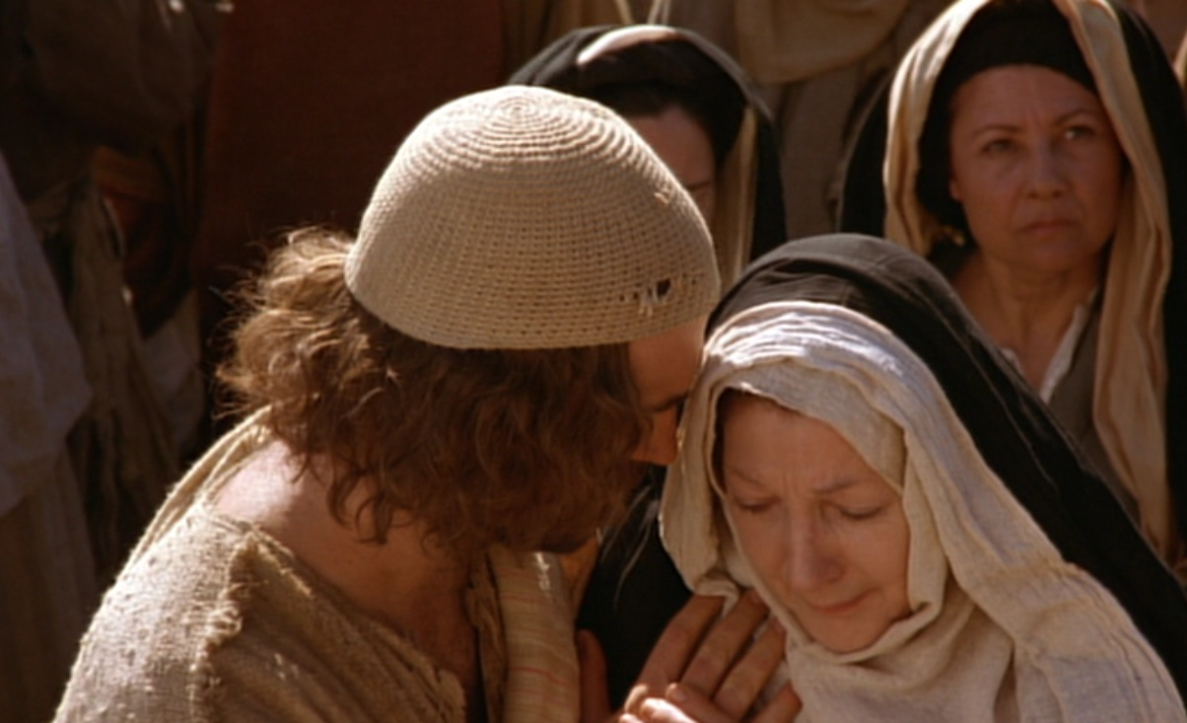
الإعتناء بأمه مريم
Notes:
He cared even after his death through John, to whom he says, “Here is your mother” (19:27).
Why John instead of Jesus’ siblings?
Remember in John 7:5 that his brothers did not even believe in Christ, unlike the beloved disciple John (13:23). But Jesus, as the Good Shepherd (10:4), cares for his own mother as he would the rest of his sheep.

Slide 31
1. تمم المسيح المكتوب من خلال موته غير الأناني (19: 16ب-37)
نكران الذات
التتميم
حمل الصليب
اقتسام الملابس
الصلب
عطشان
الإهتمام بمريم
Notes:
Jesus paid for our sin by dying to fulfill prophecy and with utmost care for others.
• Jesus showed selflessness by carrying his own cross (19:16b-17).
The typical criminal had to do this—even those crucified on either side of Christ.

Slide 32
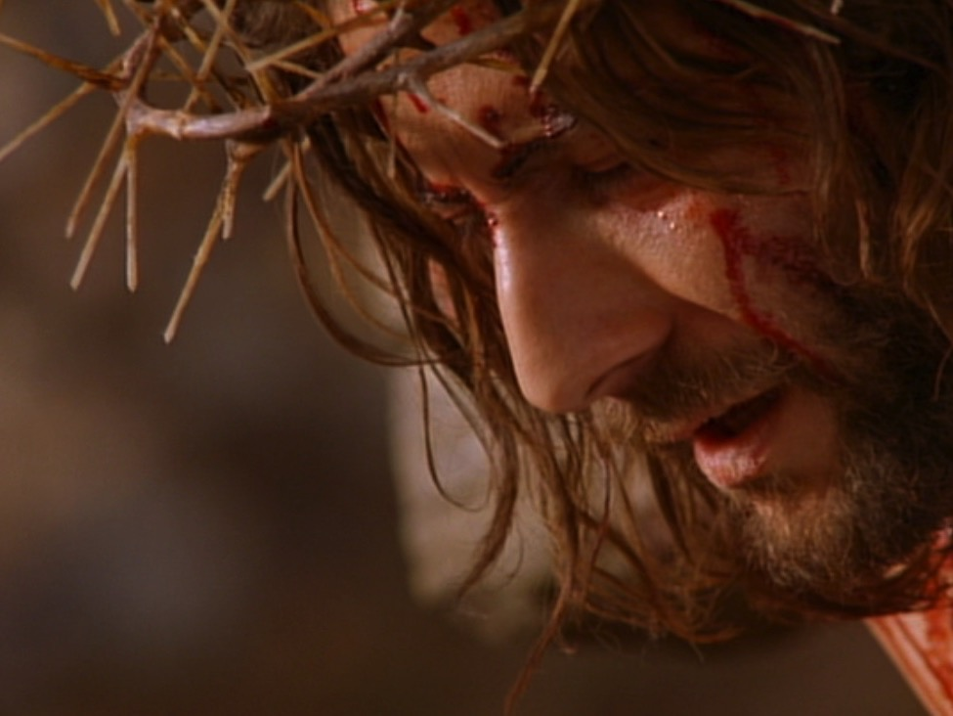
أنا عطشان
(19: 28، مز 22: 15، 69: 21)
Notes:
Psalm 22:15; 69:21 was fulfilled with Christ declaring, “I am thirsty” (John 19:28).
“I am thirsty” (19:28) shows irony, for the One who gives living water (4:14; 7:38-39) willingly allowed himself to thirst. Christ quotes Psalm 69:21 here—a psalm that ends with triumph in his fulfillment of this prophecy.

Slide 33
1. تمم المسيح المكتوب من خلال موته غير الأناني (19: 16ب-37)
نكران الذات
التتميم
حمل الصليب
اقتسام الملابس
الصلب
عطشان
الإهتمام بمريم
دفع عن الخطية
Notes:
Jesus paid for our sin by dying to fulfill prophecy and with utmost care for others.
• Jesus showed selflessness by carrying his own cross (19:16b-17).
The typical criminal had to do this—even those crucified on either side of Christ.

Slide 34
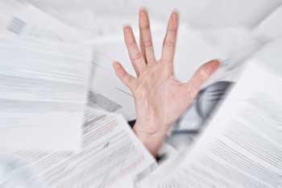
دين الخطية الثقيل
Notes:
You and I have a tremendous debt to God.
Ray Comfort illustrates it this way: Have you ever broken God’s commandment by lying? What does that make you? Yes, a liar!
Have you ever prioritized something else ahead of God? What does that make you? Yes, an idolater!

Slide 35
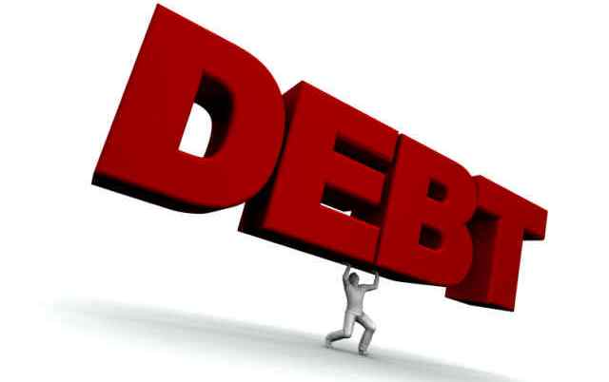
The Debt of Sin
دَين
Notes:
Suppose you only sinned three times a day—a word, action, or thought less than God—that’s 1000 sins a year! And that’s good year! How many thousands of your sins separate you from God?
We can plead that God is merciful—and he is—but his mercy is balanced with his justice that requires payment for your sin—not just token payment, but death!

Slide 36


قد أكمل
قانونياً
مدفوع
بالكامل
Notes:
When Jesus declared, “It is finished” (19:30), it was a legal term meaning “paid in full.” Our sin on him recalls the many times in John when Christ claimed that his “hour” had not yet come (2:4; 13:1, etc.). Now his “hour” had come to pay the redemption for which He had come.

Slide 37
1. تمم المسيح المكتوب من خلال موته غير الأناني (19: 16ب-37)
نكران الذات
التتميم
حمل الصليب
اقتسام الملابس
الصلب
عطشان
الإهتمام بمريم
دفع عن الخطية
الجنب المطعون
Notes:
Jesus paid for our sin by dying to fulfill prophecy and with utmost care for others.
• Jesus showed selflessness by carrying his own cross (19:16b-17).
The typical criminal had to do this—even those crucified on either side of Christ.

Slide 38
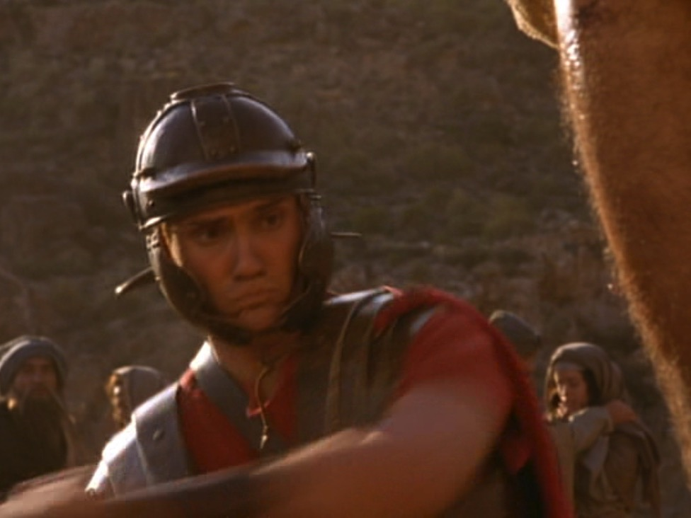
لماذا كسر الساقين ؟
Notes:
How would the breaking of a victim’s legs bring death (19:31)? The way to hasten death was to prevent the crucified man from pushing up to take a breath—so breaking the legs prevented breathing. The shock and loss of more blood by having the legs broken with a heavy mallet also hastened death.

Slide 39
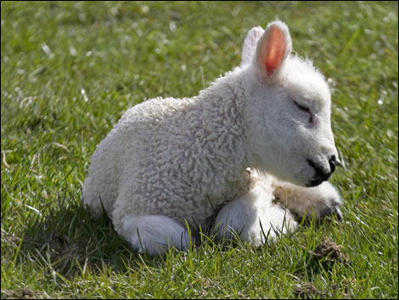
كانت حملان الفصح
لا تشوبها شائبة
Notes:
The Passover lamb was to be without a defect—including even after death. “Not one of his bones will be broken” (John 19:36 NLT) fulfilled two OT texts:

Slide 40
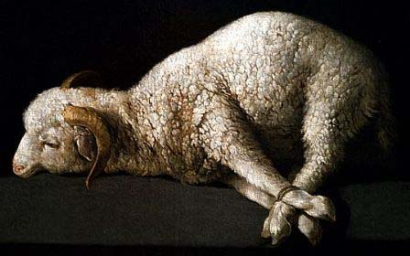
تم تخصيص حملان الفصح كاملة
دون كسر أي أرجل
في بيت واحد يؤكل لا تخرج من اللحم من البيت إلى خارج و عظماً لا تكسروا منه
خروج 12: 46، عدد 9: 12
Notes:
Exodus 12:46 commanded, “Each Passover lamb must be eaten in one house. Do not carry any of its meat outside, and do not break any of its bones.”

Slide 41
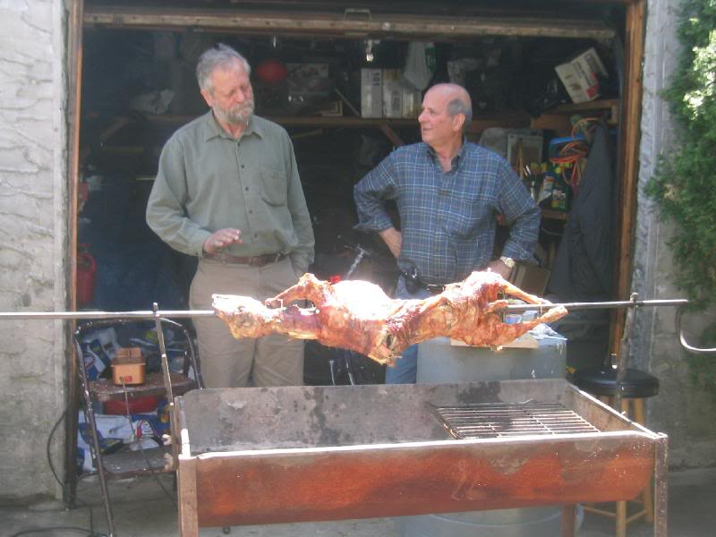
لا تزال حملان الفصح مخصصة بالكامل
دون كسر أي أرجل

Slide 42
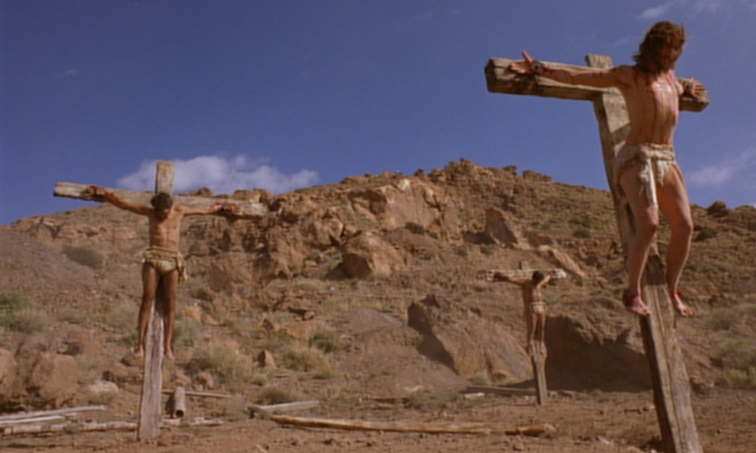
مزمور 34: 20
يحفظ جميع عظامه واحد منها لا ينكسر
Notes:
Ps. 34:20 prophesied, “For the Lord protects the bones of the righteous; not one of them is broken!”

Slide 43
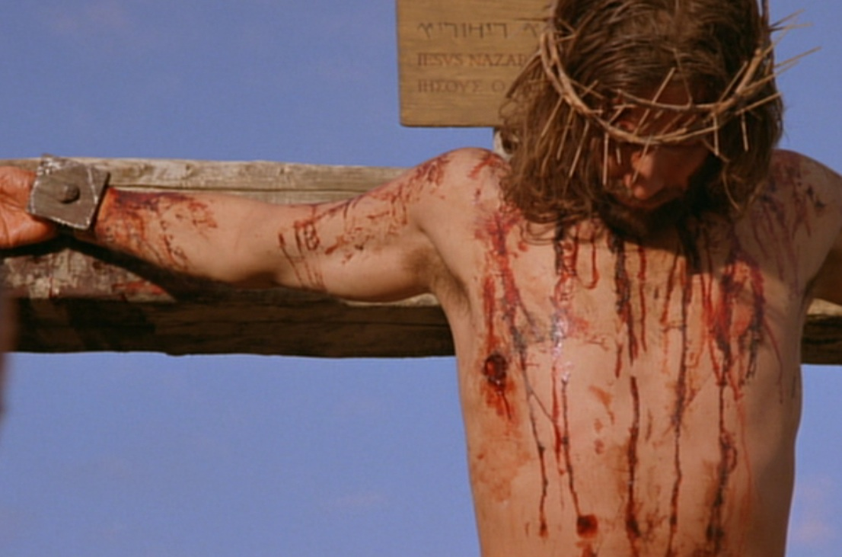
زكريا 12: 10
و أفيض على بيت داود
و على سكان أورشليم
روح النعمة و التضرعات
فينظرون إلى الذي طعنوه
و ينوحون عليه كنائح
على وحيد له
و يكونون في مرارة عليه
كمن هو في مرارة على بكره
Notes:
“They will look on the one they pierced” (Zech. 12:10) was fulfilled in John 19:37 with the soldier thrusting a spear into his side.

Slide 44
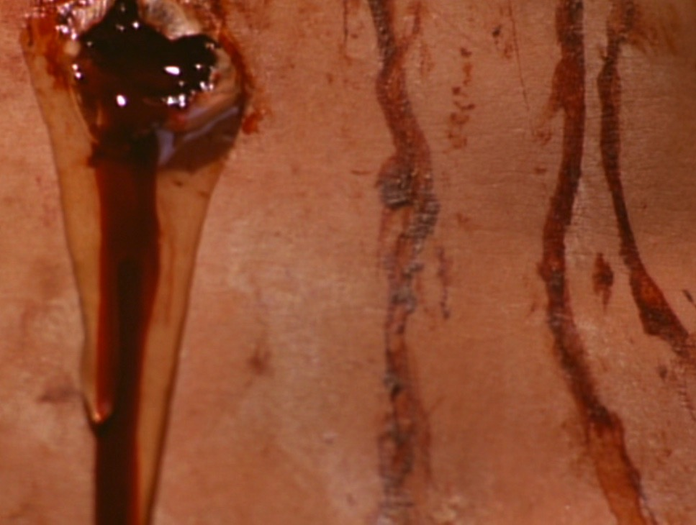
دم و ماء
سكتة قلبية ؟
هيكل جديد (2: 19) ؟
حياة من خلال دمه (1: 13) ؟
الموت (1 يوحنا 1: 1) ؟

Slide 45
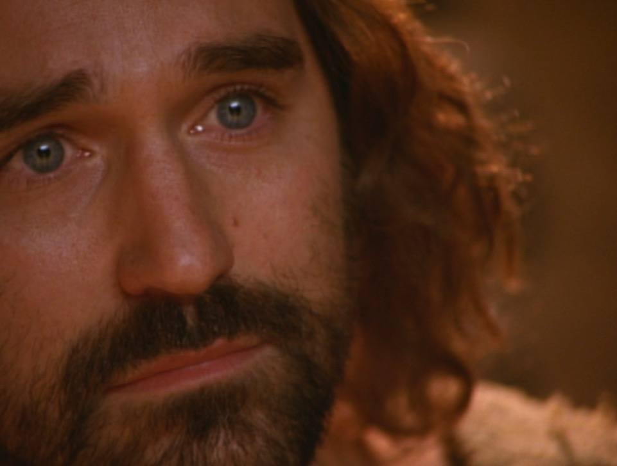
و الذي عاين شهد و شهادته حق
و هو يعلم أنه يقول الحق لتؤمنوا أنتم
(19: 35)
Notes:
To sum up, John’s purpose in verse 35 was so you and I can believe in Jesus.

Slide 46
1. تمم المسيح المكتوب من خلال موته غير الأناني (19: 16ب-37)
نكران الذات
التتميم
حمل الصليب
اقتسام الملابس
الصلب
عطشان
الإهتمام بمريم
دفع عن الخطية
الجنب المطعون
Notes:
Jesus paid for our sin by dying to fulfill prophecy and with utmost care for others.
• Jesus showed selflessness by carrying his own cross (19:16b-17).
The typical criminal had to do this—even those crucified on either side of Christ.

Slide 47
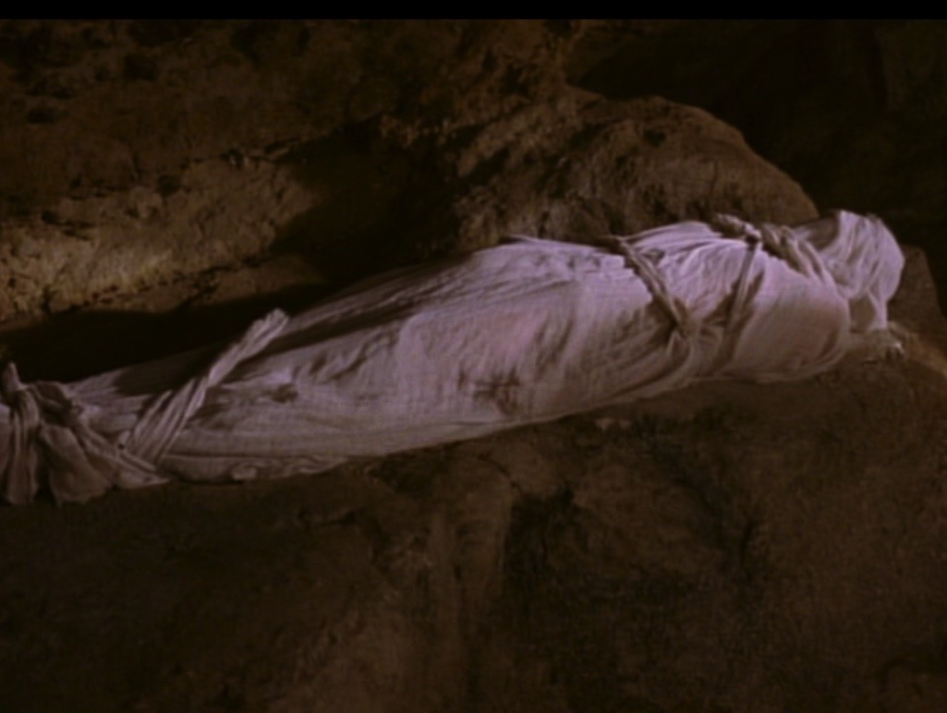
2. دفن المسيح أثبت أنه كان ميتاً بالفعل (19: 38-42)
Notes:
We know Jesus really did pay for our sin by the fact that he truly died, which sets the stage for the resurrection in John 20.

Slide 48
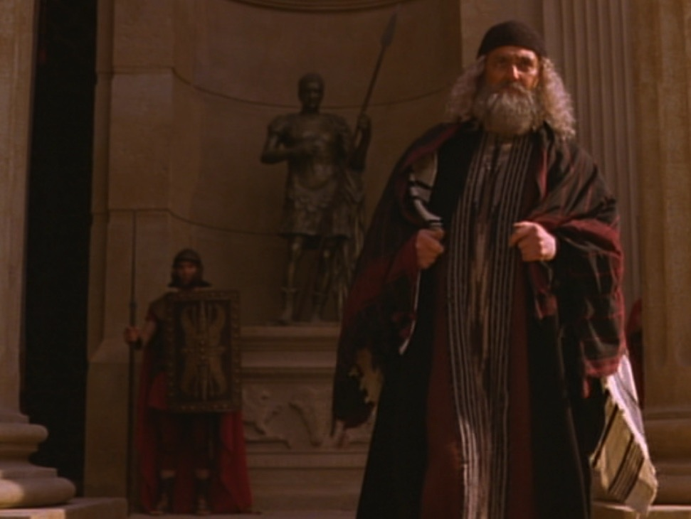
يوسف الرامي
Notes:
The previously secret believers, Joseph and Nicodemus, prepared his body for burial in 33 kilos of spices (19:38-40).

Slide 49
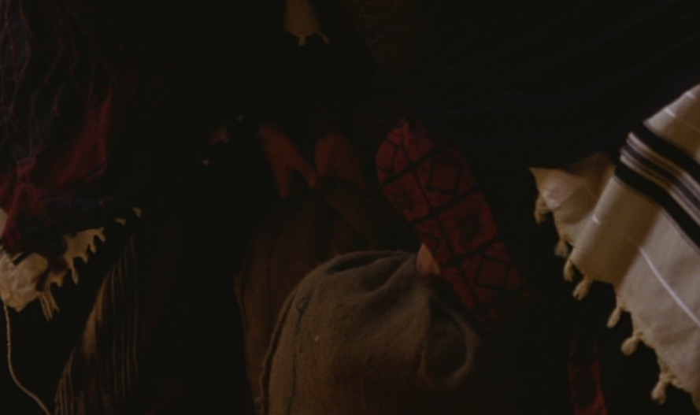
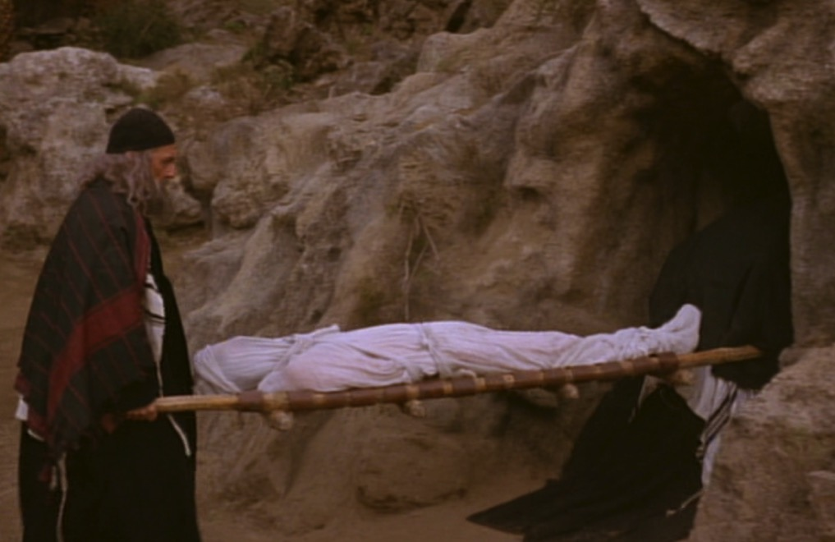
33 كيلو من الطيب
Notes:
Where could they get so many spices quickly and a brand new tomb so close by? We don’t know, but what we do know is that…

Slide 50
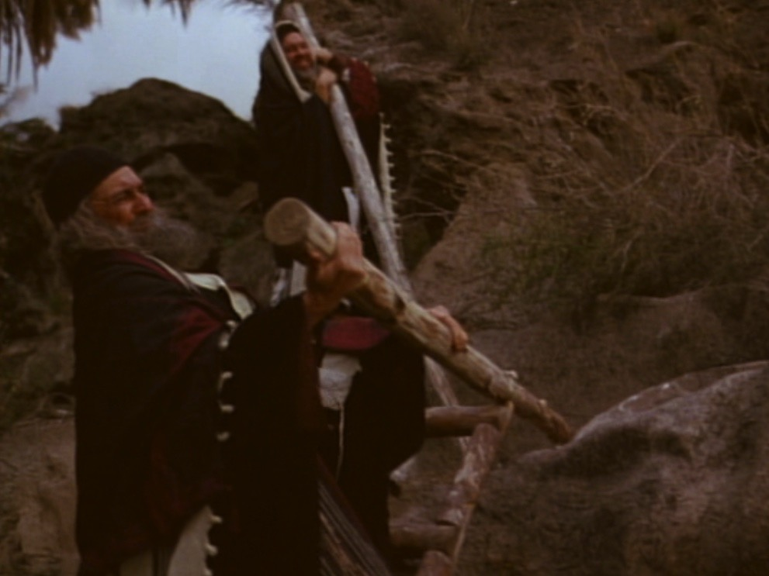
إغلاق القبر
Notes:
The appearance of these men reminds us that there exist many even today who are secret believers—men and women who feel they cannot openly declare Christ.

Slide 51
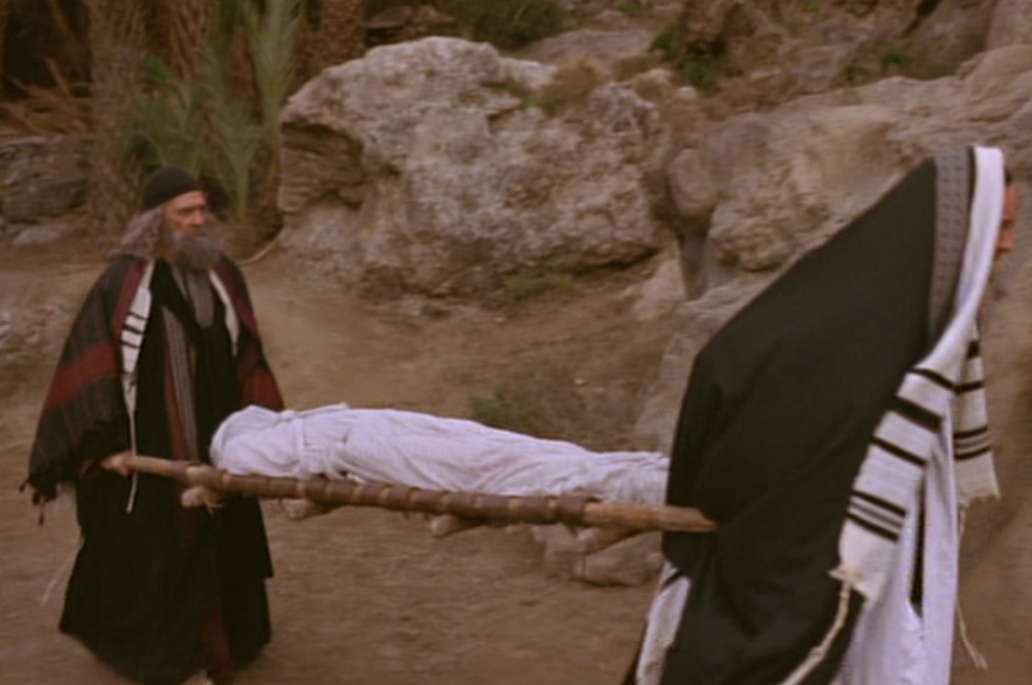
لماذا كان دفن القبر حيوياً ؟
Notes:
The body was laid in a brand new, expensive, rock-hewn garden tomb rather than in the Potter’s Field (19:41-42).
Why was it so important that Jesus was buried in a tomb?
The wrapping and burial in 33 kilos of spices proved that he was truly dead.

Slide 52
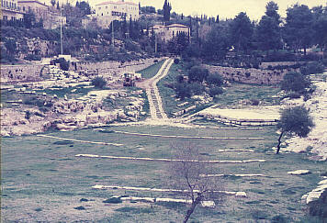
وادي هنوم
Notes:
Normally a criminal’s body was thrown into the Valley of Hinnom and burned or eaten by dogs. But if his body was burned there, claim of a resurrection would be absurd. So his enemies actually protected his body for credibility purposes!

Slide 53
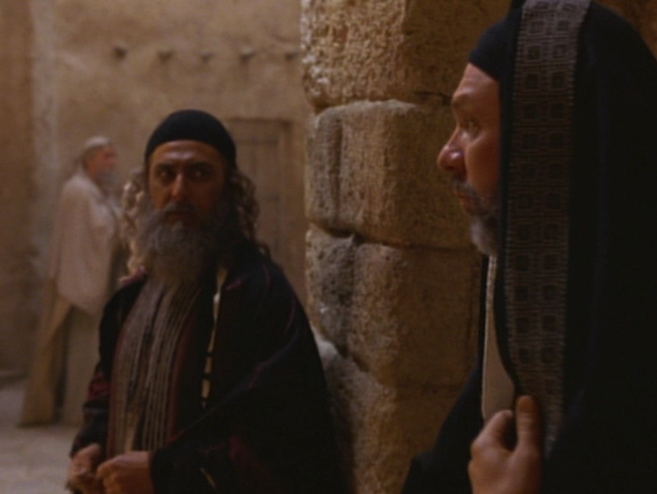
يوسف و نيقوديموس
Notes:
The tomb burial allowed secret believers Nicodemus and Joseph to come forward.

Slide 54
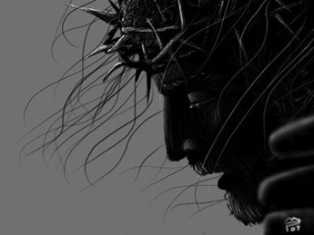
مات بالفعل
Notes:
But what was the main reason the burial of Christ is significant? It proved that Christ was indeed dead. You can’t have a resurrection unless you first have a dead man!

Slide 55
مات عنك
لكن كيف نعرف أن موت المسيح دفع ثمن خطايانا بالفعل ؟
Notes:
We began with the question, “How do we know that Christ’s death actually paid for our sin?” So how can we be sure his death was unlike any other? I sum up the whole passage in this way…

Slide 56
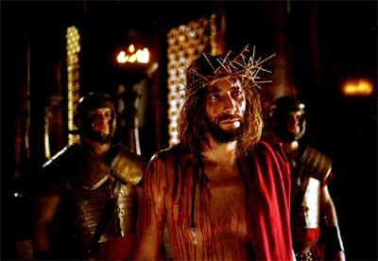
الفكرة الرئيسية
كان يجب أن يموت المسيح عن خطايانا
لأنه كان أمراً نبوياً، غير أناني و أكيد
Notes:
Jesus’ death was a selfless fulfillment of Scripture ending in tomb burial (restated MI).

Slide 57
1. تمم المسيح المكتوب من خلال موته غير الأناني (19: 16ب-37)
نكران الذات
التتميم
حمل الصليب
اقتسام الملابس
الصلب
عطشان
الإهتمام بمريم
دفع عن الخطية
الجنب المطعون
Notes:
Jesus paid for our sin by dying to fulfill prophecy and with utmost care for others.
• Jesus showed selflessness by carrying his own cross (19:16b-17).
The typical criminal had to do this—even those crucified on either side of Christ.

Slide 58
2. دفن المسيح أثبت أنه مات حقاً
(19: 38-42)

Slide 59

To End All Wars

Slide 60

إنهاء كل الحروب

Slide 61
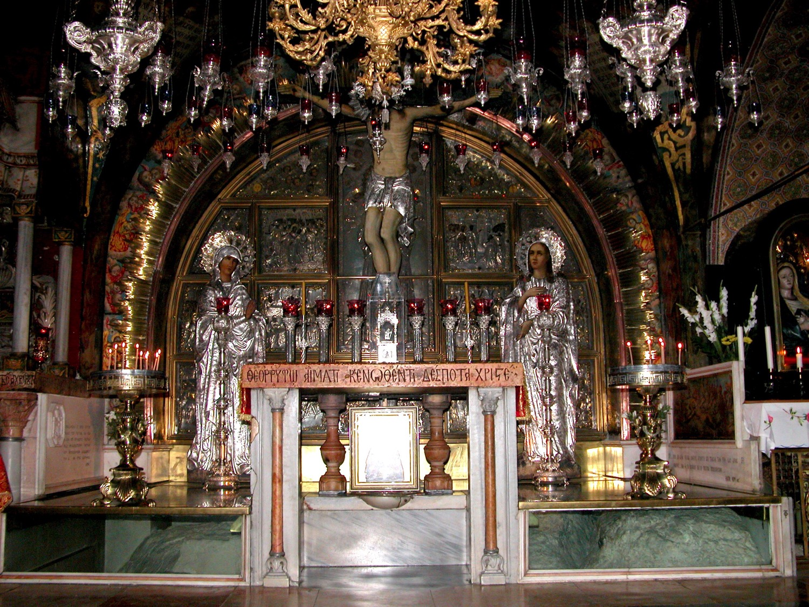
الجلجثة في كنيسة القيامة
Notes:
Visiting the tomb of Jesus can get us all caught up in the gaudy display—

Slide 62
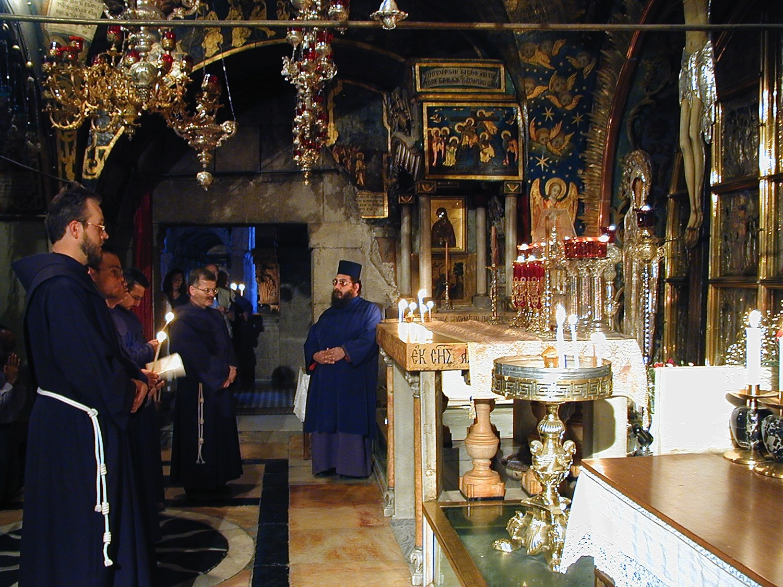
Golgotha, in The Church of the Holy Sepulcher
Notes:
—so that we miss the key point that Christ actually died for our sin.

Slide 63
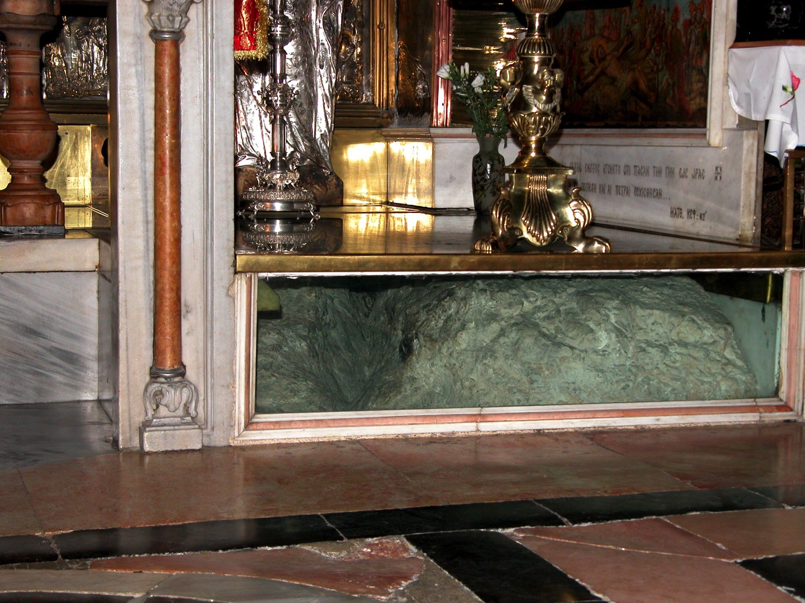
Golgotha, in The Church of the Holy Sepulcher
Notes:
The rock of Golgotha is barely seen!

Slide 64
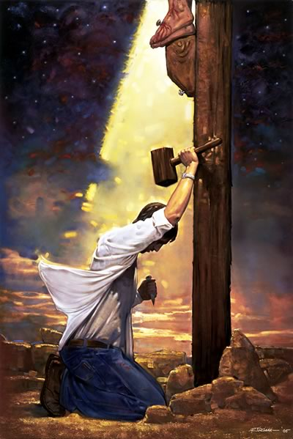
من
صلب
يسوع ؟
Notes:
Let me leave you to answer one of two questions…

Slide 65

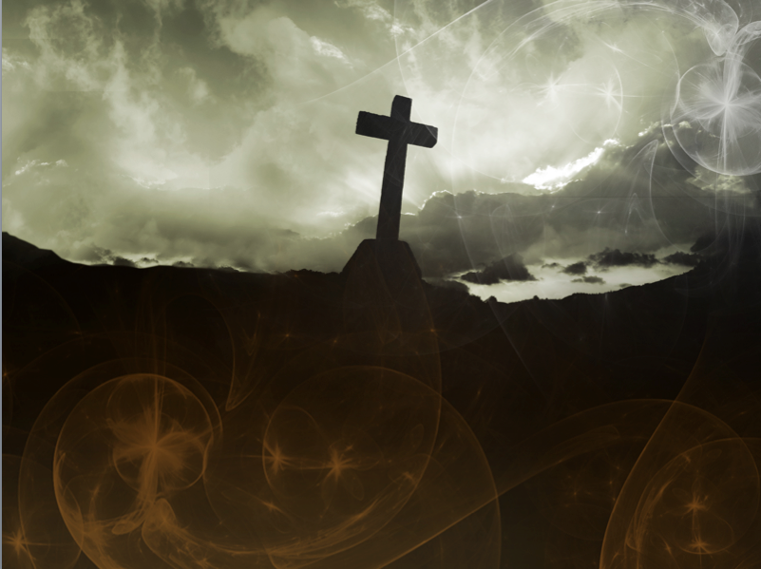
قد
أكمل
Notes:
Pre-believers: Will you trust in Christ’s death that paid for your sin?

Slide 66
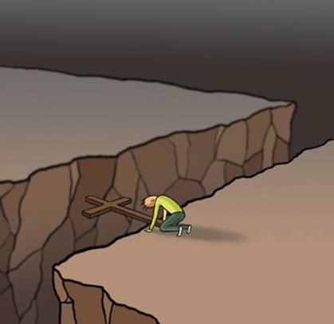
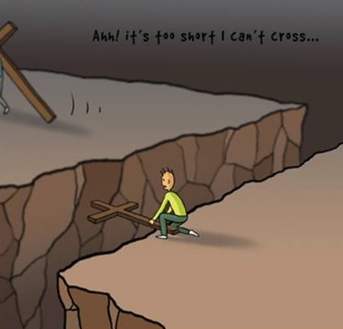
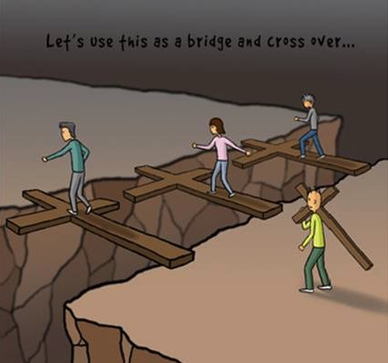











Cross Too Heavy?
Notes:
Believers: What cost could you pay that is too much for the one who died for you? Please watch this sequence of pictures…

Slide 67
Black

Slide 68


Christology link at BibleStudyDownloads.org
Get this presentation for free!
Notes:
Creation (cr)

